Slide 1
SOCIAL MEDIA AND MENTAL HEALTH ANALYSIS
Submitted by :-
Sneh Raj

Slide 2
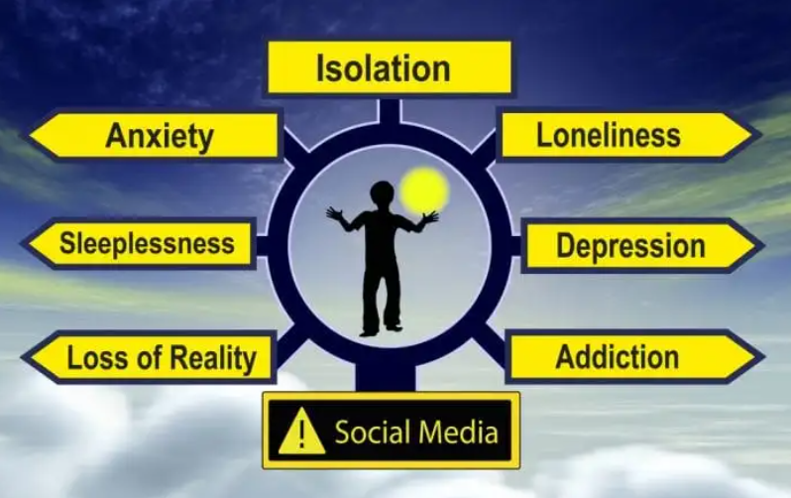
About The Dataset
Source of Dataset : Kaggle
This dataset contains various information regarding to the Social Media they use like Facebook, Instagram, Snapchat, TikTok, Pinterest etc. It also includes various aspects of Mental Health Analysis like Lack of Concentration, Distraction, Sleep issues, Lack of Interests, Feeling of Depression, Seeking Validation from Others, Comparing with others etc. This Dataset has total 481 entries i.e. Sample Size is 481.
(Image Source : Clay Behavioural Health Centre)

Slide 3
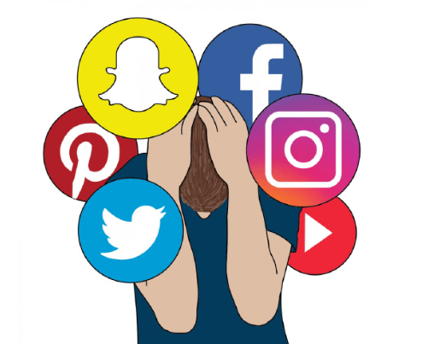
Project Objective
The main objective of this project is to analyse the Dataset and draw impactful insights in the role of Social Media on Mental Health of its users. Various aspects of which including distractions, restlessness, sleep issues, fluctuation of interests, comparison with others, difficulty in concentrations etc.
(Image Source : Lets Get Happi)

Slide 4
Steps Involved
Step-1 :- Data Cleaning : This step involves Handling Missing values, Removing Duplicates and Removing Unwanted Columns.
Step-2 :- Data Analysis and Visualization : This step involves performing Analysis along with preparing different charts for visualization.
Step-3 :- Final Conclusion : This step involves drawing impactful conclusion from different charts and suggesting some ways in favour of them.
Tools Used :- Python Programming (Google Colab), Pandas, Microsoft Excel, Microsoft PowerPoint.

Slide 5
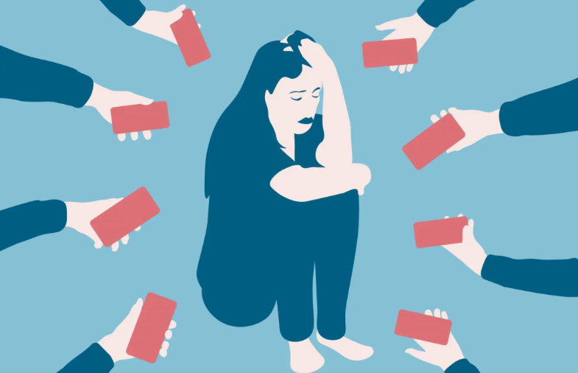
Key Insights
Time Spent vs Distraction & Concentration
This is one of the most important concern in recent
times that how much we get distracted and lack in our
Concentration by using Social Media.
From the given graph (attached in next page)
we can infer that as we use Social Media more,
we get distracted and lack in our Concentration.
Hence, it impacts our Focus.
(Image Source : LinkedIn)

Slide 6
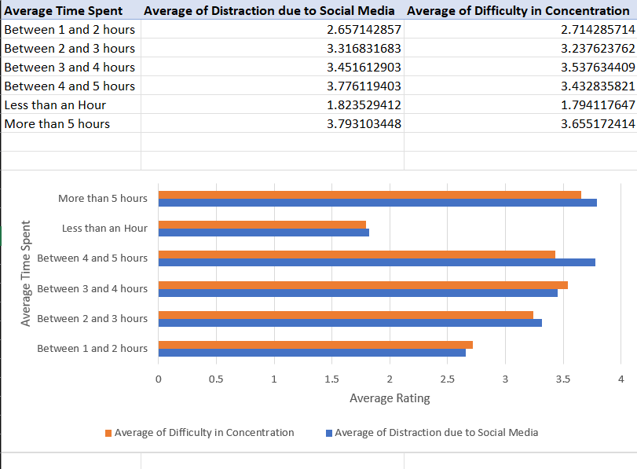

Slide 7
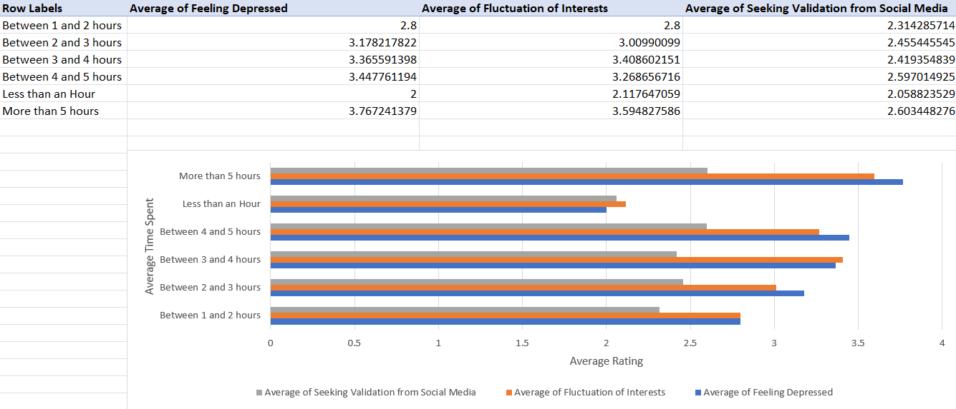
Key Insights
Time Spent vs Depression, Seeking Validation, Fluctuation of Interests

Slide 8
Key Insights
Some other parameters which gets affected by primarily Social Media now-a-days are Feeling of Depression, Seeking Validation from Others and Fluctuation of Interests.
Clearly, in this graph we can see that all those Negative factors impact us if we use more Social Media.

Slide 9
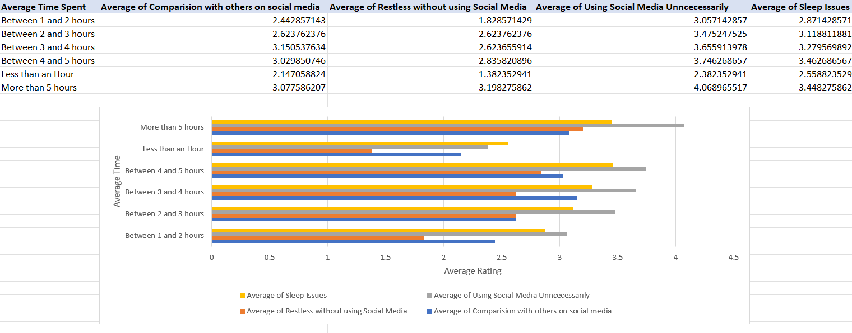
Key Insights

Slide 10
Key Insights
Time Spent vs Other Insecurities
Some other negative impacts of using more Social Media are Sleep Issues, Indulging
more on Social Media Content, Feeling of Restless and Comparision with
Others. As we use more Social Media, we get more in this trap.

Slide 11
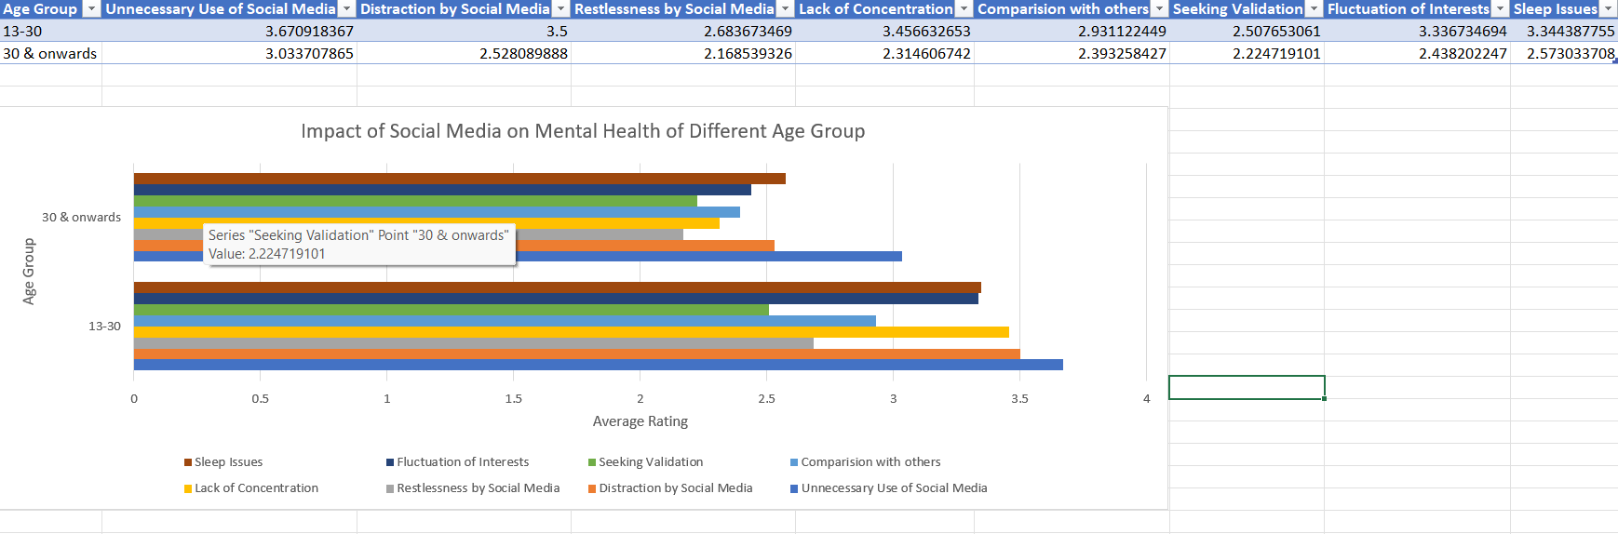
Key Insights
Effect of Social Media on Different Age Groups

Slide 12
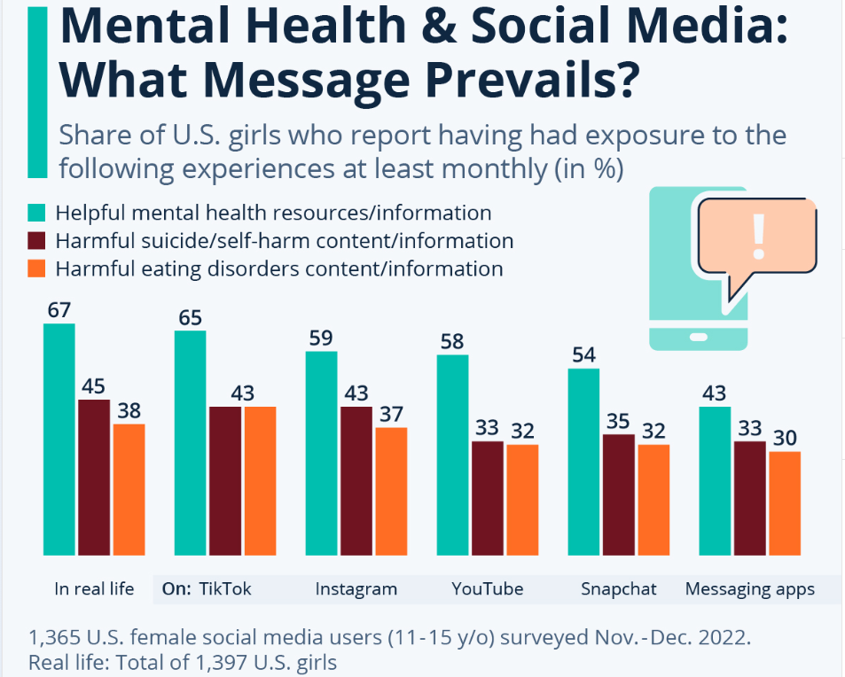
Key Insights
From previous chart, we can clearly state that in each and every aspect, Youths (of age group 13-30 years) are indulged more into Social Media which is one of the major reasons of their low productivity as compared to People of Age group of 30+.
(Image Source : Common Sense Media)

Slide 13
Conclusion
Main Conclusions that can be drawn from above Insights are as follows :-
Average Time Spent on Social Media Platform on Daily basis is directly proportional to bad mental health i.e. users who spent more time on Social Media gets more distracted, less concentrated, have more doubt on himself, face more fluctuating interests etc.
Youths of Age Group 13 – 30 years are more indulged into Social Media and hence facing its drawbacks directly including bad Mental Health which isn’t good for them, for their career and for their life.

Slide 14
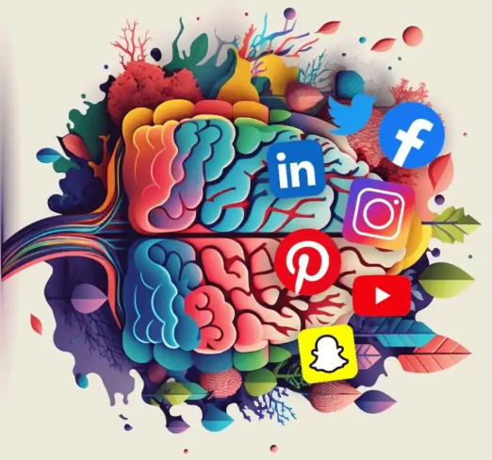
Suggestion
Some suggestion to improve this condition includes –
Youths should focus more on real world rather than focusing on virtual world.
Limit Social Media usage to under 1 hour for better mental health and real exposure to this world.
(Image Source : Divided We Fall)

